Slide 1

B & J BISCUIT COMPANY
RETAIL SALES ANALYSIS

Slide 2
DATA SET OVERVIEW
Excel formulas such as SUM, AVERAGE, FILTER, VLOOKUP, TEXT FUNCTIONS, TRIM were used to clean data, calculated key metrics and also used pivot tables to organize and analyze the sales data with visualization
EXCEL HEADERS
Transaction date
Buyer name and location
Buyer date of birth
Payment method
Quantity purchased
Product code
Sales representative
gender
B & J Biscuit Company | Retail Sales Analysis

Slide 3
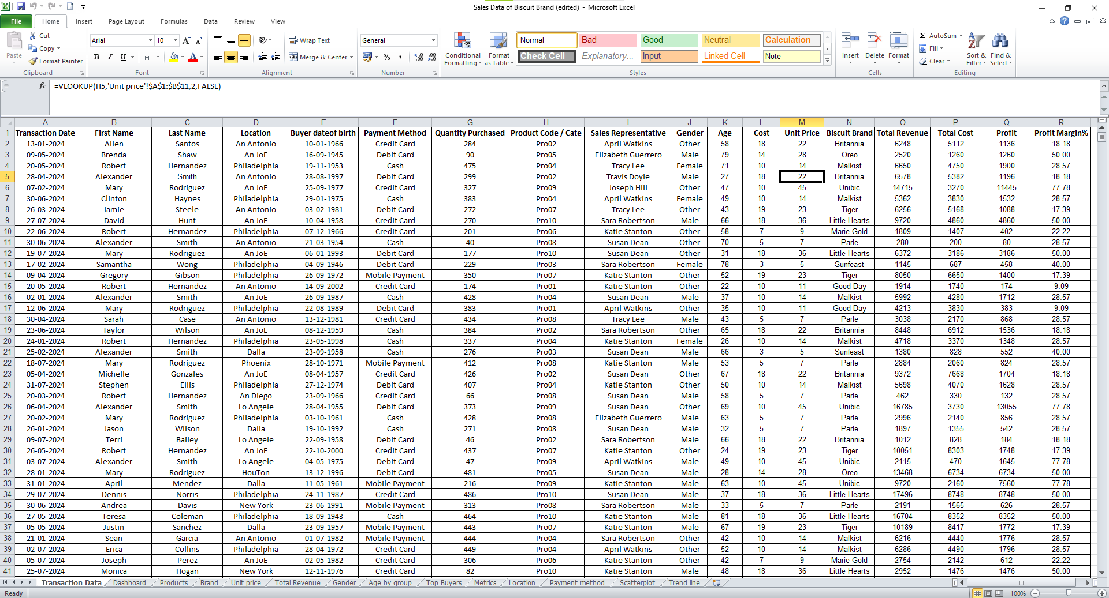
DATA CLEANING
B & J Biscuit Company | Retail Sales Analysis

Slide 4
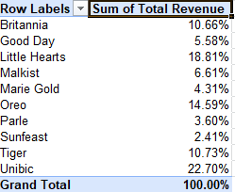
REVENUE BY PRODUCTS
INSIGHTS:
UNIBICS tops the performance
Followed by LITTLE HEARTS and OREO
SUNFEAST is the poor performer
B & J Biscuit Company | Retail Sales Analysis

Slide 5
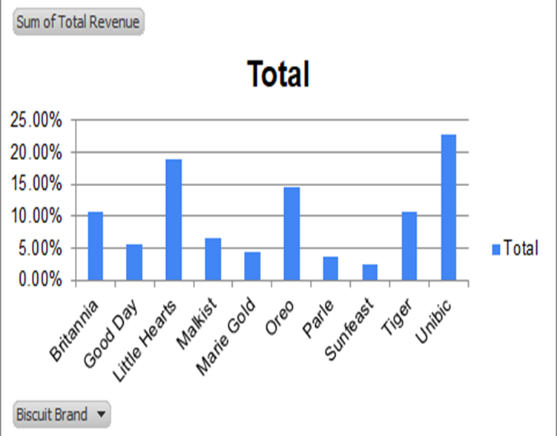
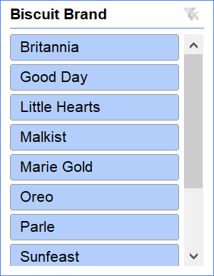
B & J Biscuit Company | Retail Sales Analysis

Slide 6
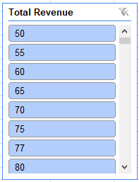
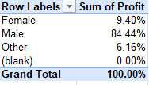
GENDER ANALYSIS
B & J Biscuit Company | Retail Sales Analysis

Slide 7
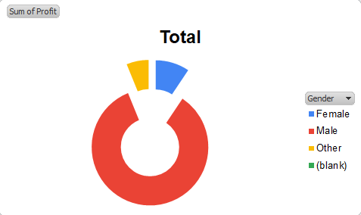
GENDER ANALYSIS
MALE alone contributes about 84.44% in total profits
B & J Biscuit Company | Retail Sales Analysis

Slide 8
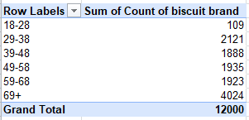
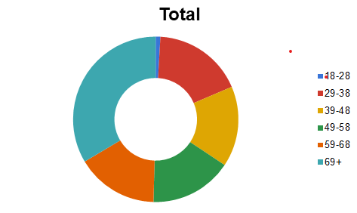
AGE GROUP ANALYSIS
69+ age group people bus biscuits often
Biscuits are rarely purchased by 18-28 age category
B & J Biscuit Company | Retail Sales Analysis

Slide 9
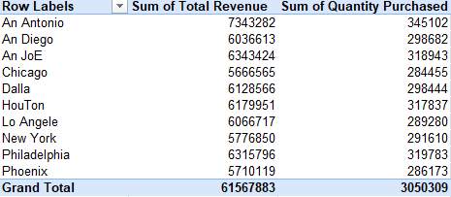
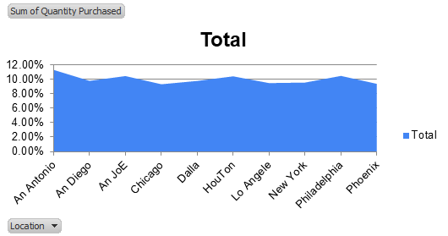
ANALYSIS BY LOCATION
An Antonio tops the sales by location
B & J Biscuit Company | Retail Sales Analysis

Slide 10
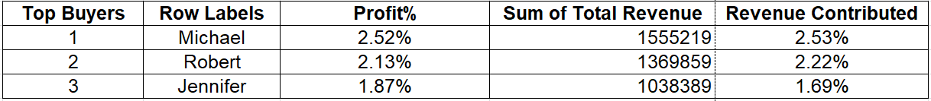
TOP BUYERS
B & J Biscuit Company | Retail Sales Analysis

Slide 11
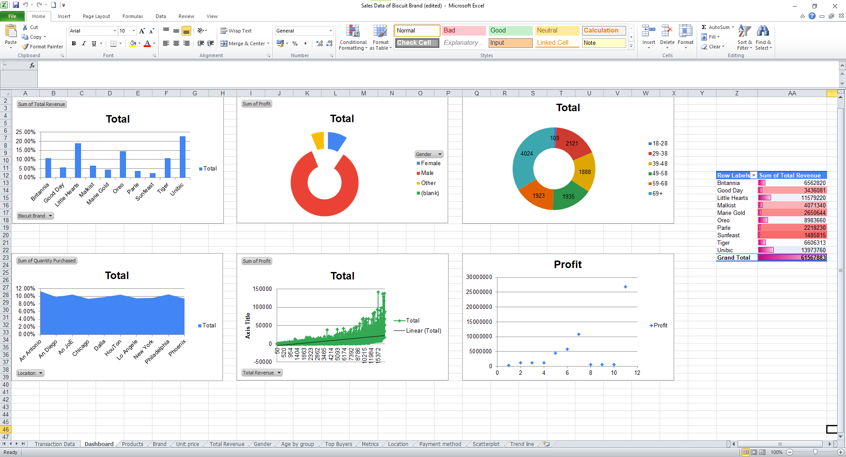
DASHBOARD
B & J Biscuit Company | Retail Sales Analysis

Slide 12
KEY INSIGHTS
★
⚠
TOP PRODUCT
GROWTH OPPORTUNITY
The highest revenue-generating product is
UNIBICS
Purchased mostly by
MALE | Age 69+
Least selling brand that needs focus
SUNFEAST
Target demographic
Age Group | 29 - 38
B & J Biscuit Company | Retail Sales Analysis

Slide 13
THANK YOU
B & J Biscuit Company | Retail Sales Analysis

